Slide 1

I AM A CHILD OF GOD
Called by name.
I am loved, chosen,
And graced by God.
Today, I decide to humble
myself and serve.
I stir up my faith to say,
“GOD IS HERE SO ANYTHING IS POSSIBLE.”

Slide 2
TODAY I DECLARE:
People are my Passion.
His Mission is my Mission,
His House is my Priority,
Excellence is my Standard,
Generosity is my Privilege.
All of these are for Him;
THIS IS HIS DAY, HIS HOUSE,
HIS HOUR, AND IT ALL STARTS NOW!

Slide 3
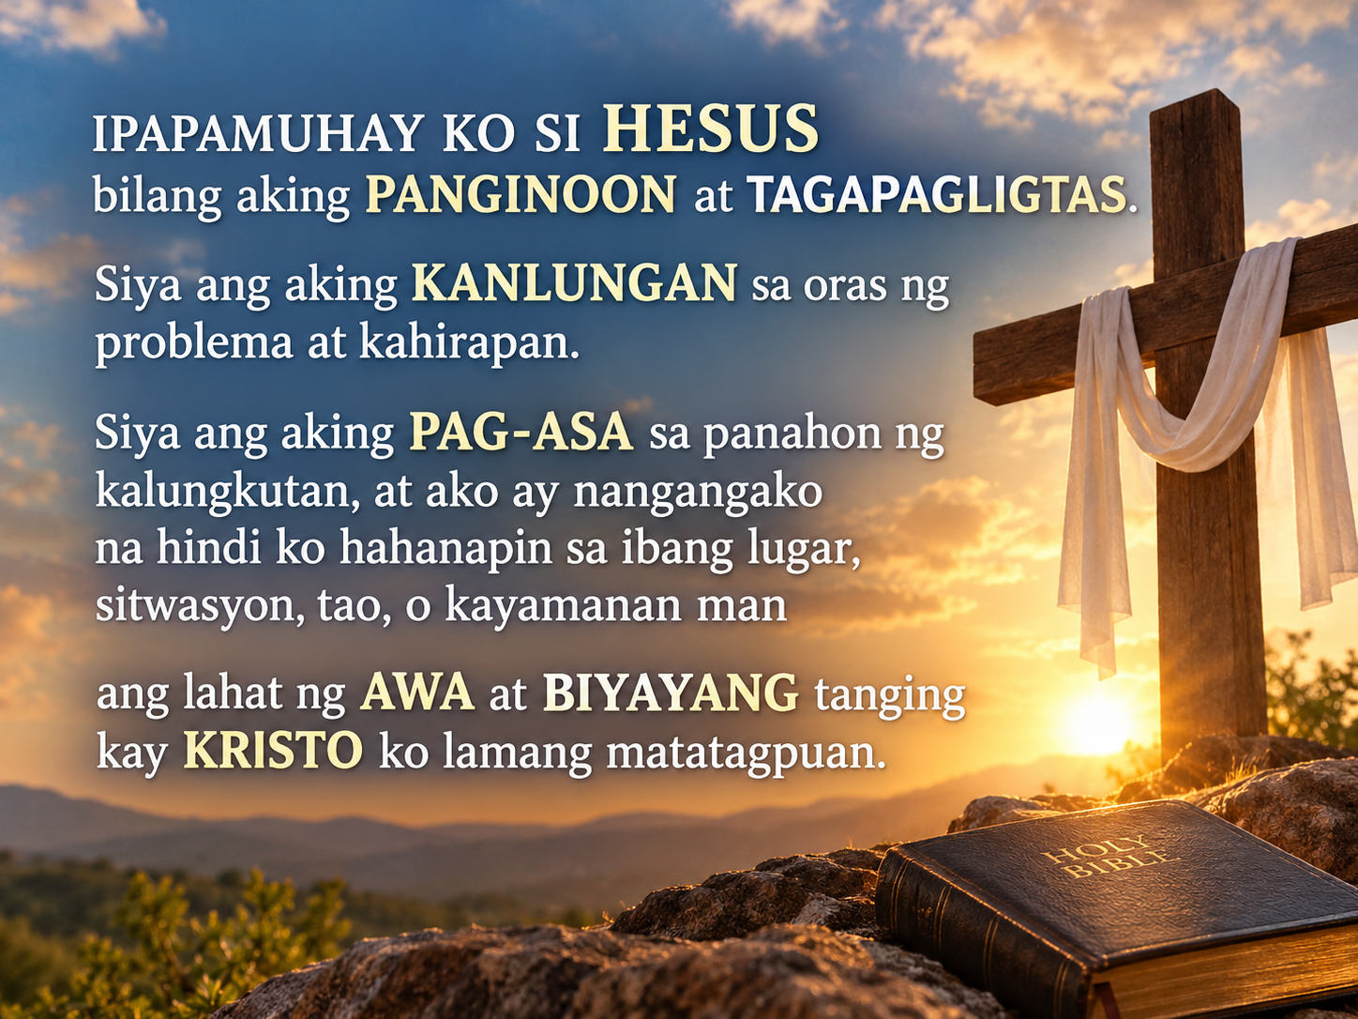

Slide 4
